Slide 1



By : Hrushikesh Ramilla
22/12/2024

Slide 2

Outline
Executive Summary
Introduction
Methodology
Results
Conclusion
Appendix

Slide 3
Executive Summary
Summary of methodologies
Data collection –
Data wrangling –
Exploratory Data Analysis
Data Visualization
Data Analysis with SQL
Building an interactive map with Folium
Building a Dashboard with Plotly Dash
Training Machine learning models
Summary of all results

Slide 4
Introduction
Project Background and Context
SpaceX, a pioneering force in the commercial space industry, has revolutionized space travel by significantly reducing launch costs. Central to this innovation is the reusable Falcon 9 rocket, which brings down launch costs to $62 million compared to the industry standard of $165 million or more. This cost reduction is largely achieved through the ability to recover and reuse the rocket's first stage.
The ability to predict whether the first stage will successfully land is critical for cost-efficiency. By leveraging publicly available data and machine learning models, this project aims to explore the factors influencing landing success and provide actionable insights.
Problems to Solve
This project seeks to address the following key questions:
1. Impact of Key Variables: How do factors such as payload mass, launch site, number of flights, and orbital type affect the success of first-stage landings?
2. Historical Trends: Has the success rate of landings improved over the years, and what insights can be derived from this trend?
3. Optimal Classification Algorithm: What is the most effective machine learning algorithm for predicting binary outcomes (success vs. failure) in this context?

Slide 5

Section 1

Slide 6
Methodology
Executive Summary
This project involves a comprehensive approach to analyze SpaceX’s rocket launch data, utilizing a combination of data collection, preprocessing, exploration, interactive analytics, and machine learning techniques. Key steps include:
Data Collection:
Gathering relevant data using SpaceX REST API and web scraping from Wikipedia.
Data Wrangling:
Processing data to ensure consistency, completeness, and suitability for analysis.
Exploratory Data Analysis (EDA):
Employing SQL and data visualization to uncover insights and patterns.
Interactive Analytics:
Visualizing data geographically and interactively using Folium and Plotly Dash.
Predictive Analysis:
Building, tuning, and evaluating classification models to predict landing success.

Slide 7
Data Collection
The data collection for this project involved two main methods: SpaceX REST API and Web Scraping. Below is the structured process with key phrases and a flowchart representation.
Key Steps:
Using SpaceX REST API:
Requesting rocket launch data via API endpoints.
Decoding JSON response and normalizing it into a structured dataframe.
Filtering data to focus only on Falcon 9 launches.
Replacing missing values (e.g., calculating mean for payload mass).
Exporting the cleaned data to a CSV file.
Web Scraping from Wikipedia:
Sending HTTP requests to the SpaceX Wikipedia page.
Creating a BeautifulSoup object to parse HTML content.
Extracting column names and data from HTML tables.
Organizing the data into a structured dataframe.

Slide 8
Data Collection
Exporting the scraped data into a CSV file.
Combining Datasets:
Merging API and scraped data for a complete analysis.
Ensuring consistent formatting and handling duplicates or discrepancies.
Output:
Final datasets stored in CSV format, ready for further analysis.

Slide 9
Data Collection – SpaceX API
Start
↓
Request Data via API
↓
Decode JSON Response
↓
Normalize into DataFrame
↓
Filter for Falcon 9 Launches
↓
Handle Missing Values (Payload Mass Mean)
↓
Export to CSV
↓
End
Add the GitHub URL of the

Slide 10
Data Collection - Scraping
Start
↓
Send HTTP Request to Wikipedia
↓
Parse HTML with BeautifulSoup
↓
Extract Data from HTML Tables
↓
Organize Data into DataFrame
↓
Export to CSV
↓
End
Start
↓
Import API CSV
↓
Import Web Scraping CSV
↓
Merge DataFrames
↓
Handle Duplicates/Discrepancies
↓
Output Final CSV
↓
End

Slide 11
Data Wrangling
Data Wrangling Process
Data wrangling involved cleaning, transforming, and organizing the collected data to prepare it for analysis. The key tasks included filtering, dealing with missing values, encoding, and labeling. Here's an overview of the process with key phrases and a flowchart.
Key Steps:
Filtering Data:
Retained only relevant columns (e.g., FlightNumber, PayloadMass, LaunchSite).
Focused on Falcon 9 launches and omitted irrelevant records.
Handling Missing Values:
Identified missing data (e.g., in PayloadMass).
Replaced missing values with the column's calculated mean.
Encoding Categorical Data:
Applied One-Hot Encoding for variables like LaunchSite and Orbit to transform them into numerical formats suitable for machine learning.
Creating Labels:
Converted mission outcomes into binary labels: 1 for successful booster landings., 0 for unsuccessful landings.
Categorized landing outcomes (e.g., True/False for drone ship or ground pad landings).

Slide 12
Data Wrangling
Start
↓
Filter Relevant Columns
↓
Focus on Falcon 9 Launches
↓
Identify Missing Values
↓
Replace Missing Values (e.g., Payload Mass Mean)
↓
Apply One-Hot Encoding to Categorical Data
↓
Create Binary Labels for Landing Outcomes
↓
Export Cleaned Dataset to CSV
↓
End

Slide 13
EDA with Data Visualization
Charts Plotted and Their Purpose
Scatter Plots:
Purpose: To analyze relationships between variables, e.g., Flight Number vs. Payload Mass, Payload Mass vs. Launch Site.
Insight: Identified trends, such as payload mass influencing success rates.
Bar Charts:
Purpose: To compare discrete categories like launch sites and orbit types.
Insight: Showed variations in success rates across launch sites and orbits.
Line Charts:
Purpose: To observe trends over time, e.g., success rate yearly trends.
Insight: Demonstrated an increasing success rate since 2013.
Other Analyses:
Payload Mass vs. Orbit Type: Explored success rates based on payload and orbit combinations.
Flight Number vs. Orbit Type: Evaluated whether flight frequency impacted success rates.

Slide 14
EDA with SQL
SQL Queries Performed :
Unique Launch Sites
Displayed the names of all unique launch sites in the dataset.
Launch Sites Starting with CCA:
Retrieved 5 records where launch site names begin with "CCA.“
Total Payload Mass by NASA (CRS):
Calculated the total payload mass carried by boosters launched under NASA's CRS missions.
Average Payload Mass by Booster Version (F9 v1.1):
Found the average payload mass carried by the F9 v1.1 booster version.
First Successful Ground Landing Date:

Slide 15
EDA with SQL
Identified the date of the first successful landing outcome on a ground pad.
Successful Drone Ship Landings (Payload Range 4000-6000):
Listed boosters with successful drone ship landings and payloads within the specified range.
within a specified date range in descending order.
Mission Outcome Counts:
Counted the total number of successful and failed mission outcomes.
Boosters with Maximum Payload:
Listed booster versions carrying the maximum payload mass.
2015 Failed Drone Ship Landings:
Detailed failed landings on drone ships, with booster versions and launch sites for 2015.
Ranked Landing Outcomes (2010-2017):
Ranked landing outcomes (success/failure) within a specified date range in descending order.

Slide 16
Build an Interactive Map with Folium
Map Objects Added to Folium Map
Markers:
Placed markers for all launch sites with labels and popup information.
Purpose: To highlight the geographical locations and proximity to the equator and coasts.
Colored Markers:
Green for successful launches and red for failed launches using a marker cluster.
Purpose: To visualize success rates at each launch site.
Circles:
Added circular markers around launch sites.
Purpose: To emphasize areas of interest and proximity for each launch site.
Lines:
Created lines showing distances from KSC LC-39A to nearby infrastructures (e.g., railway, highway, coastline, closest city).
Purpose: To analyze the safety and logistical considerations of launch site locations.

Slide 17
Build a Dashboard with Plotly Dash
Dashboard Plots/Graphs and Interactions
Dropdown for Launch Sites:
Allows users to select specific launch sites.
Purpose: Enables focused analysis of success rates for individual sites.
Pie Chart:
Displays total successful launches or the success vs. failure ratio for a selected site.
Purpose: Provides a clear overview of success rates across all or selected sites.
Slider for Payload Mass Range:
Adjusts the payload mass range to filter data.
Purpose: Facilitates analysis of launch outcomes for varying payload masses.
Scatter Plot:
Shows the correlation between payload mass and success rate for different booster versions.
Purpose: Highlights how payload influences launch success rates.

Slide 18
Predictive Analysis (Classification)
Model Development Process
Key Steps:
Data Preparation:
Standardized features using StandardScaler.
Split the dataset into training and testing sets using train_test_split.
Model Selection and Training:
Built multiple models: Logistic Regression, Support Vector Machines (SVM), Decision Tree, and K-Nearest Neighbors (KNN).
Applied GridSearchCV with 10-fold cross-validation to find optimal hyperparameters.
Evaluation:
Assessed models using accuracy, F1-score, and Jaccard index on the test set.
Examined confusion matrices to evaluate false positives and negatives.

Slide 19
Predictive Analysis (Classification)
Improvement:
Tuned hyperparameters and re-evaluated models for better performance.
Best Model Selection:
Identified the Decision Tree as the best-performing model due to its highest accuracy and F1-score.

Slide 20
Predictive Analysis (Classification)
Start
↓
Prepare Data (StandardScaler, Train-Test Split)
↓
Train Models (LogReg, SVM, Decision Tree, KNN)
↓
Hyperparameter Tuning with GridSearchCV
↓
Evaluate Models (Accuracy, F1-Score, Jaccard Index)
↓
Compare Performance
↓
Select Best Model (Decision Tree)
↓
End

Slide 21
Exploratory Data Analysis Results
Flight Number vs. Launch Site:
Early flights mostly failed, while later ones showed high success.
Launch sites like KSC LC-39A and VAFB SLC-4E had higher success rates.
Payload Mass vs. Launch Site:
Higher payload mass correlated with higher success rates.
KSC LC-39A had a 100% success rate for payloads under 5500 kg.
Success Rate vs. Orbit Type:
Orbits like GEO, SSO, and ES-L1 had 100% success rates, while SO had 0%.
Yearly Success Rate Trend:
Launch success rates increased consistently from 2013 to 2020.
5. **Orbit Type Insights:**
- Heavy payloads negatively affected GTO success but positively impacted LEO and ISS.
---
### **Predictive Analysis Results**
1. **Model Performance:**
- Evaluated Logistic Regression, SVM, Decision Tree, and KNN models.
- Metrics used: Accuracy, Jaccard index, and F1-score.
2. **Best Model:**
- **Decision Tree Model** achieved the highest accuracy and F1-score.
3. **Insights from Confusion Matrix:**
- Identified areas for improvement in predicting false positives and negatives.
4. **Key Finding:**
- Launches with lower payload mass showed better success rates.
---

Slide 22
Exploratory Data Analysis Results
Orbit Type Insights:
Heavy payloads negatively affected GTO success but positively impacted LEO and ISS.
Predictive Analysis Results
Model Performance:
Evaluated Logistic Regression, SVM, Decision Tree, and KNN models.
Metrics used: Accuracy, Jaccard index, and F1-score.
Best Model:
Decision Tree Model achieved the highest accuracy and F1-score.

Slide 23
Predictive Analysis Results
Insights from Confusion Matrix:
Identified areas for improvement in predicting false positives and negatives.
Key Finding:
Launches with lower payload mass showed better success rates.

Slide 24

Section 2

Slide 25
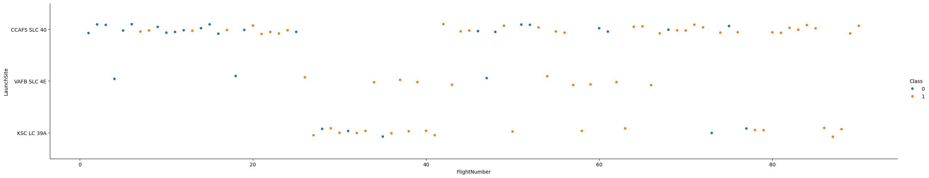
Flight Number vs. Launch Site
The graph comparing Flight Number vs. Launch Site highlights the following key results:
Success Trend: Early flights predominantly failed, while recent flights demonstrate a significant increase in success rates.
Launch Site Insights:
The CCAFS SLC-40 site accounted for about half of all launches.
Sites like VAFB SLC-4E and KSC LC-39A show higher success rates compared to others.
Progression Over Time: Each new launch seems to improve the likelihood of success, indicating advancements in technology and operational efficiency.
These insights underline the growing reliability of SpaceX launches over time and the critical role of specific launch sites in achieving success.

Slide 26
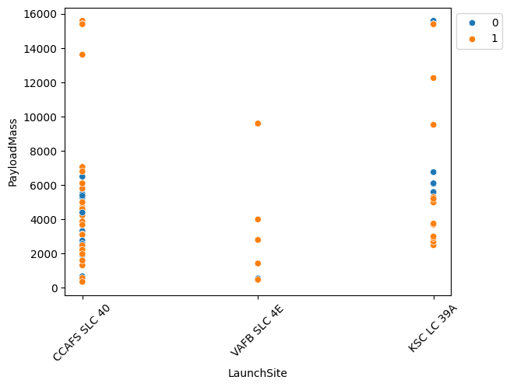
Payload vs. Launch Site
The Payload vs. Launch Site graph reveals the following insights:
Higher Payloads, Higher Success Rates: Across all launch sites, missions with heavier payloads generally demonstrate better success rates.
Threshold for Success: Most launches with payload masses exceeding 7000 kg were successful.
Site-Specific Performance:
KSC LC-39A stands out with a 100% success rate for payloads under 5500 kg, showcasing its reliability for smaller payloads.
These findings emphasize the importance of payload optimization and the influence of launch site selection on mission success.

Slide 27
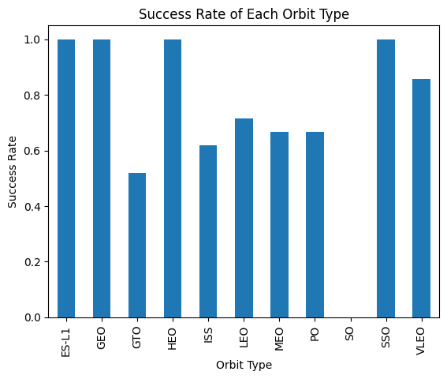
Success Rate vs. Orbit Type
The Success Rate vs. Orbit Type graph provides the following insights:
Orbits with 100% Success Rate:
ES-L1, GEO, HEO, and SSO demonstrate perfect success rates, indicating high reliability for these orbit types.
Orbits with 0% Success Rate:
SO has no successful missions, highlighting challenges or limited attempts for this orbit.
Moderate Success Rates (50%-85%):
GTO, ISS, LEO, MEO, and PO show varied performance, with success rates influenced by payloads, mission complexity, and other factors.
This analysis shows that orbit type significantly impacts mission success, with certain orbits offering more predictable outcomes.

Slide 28
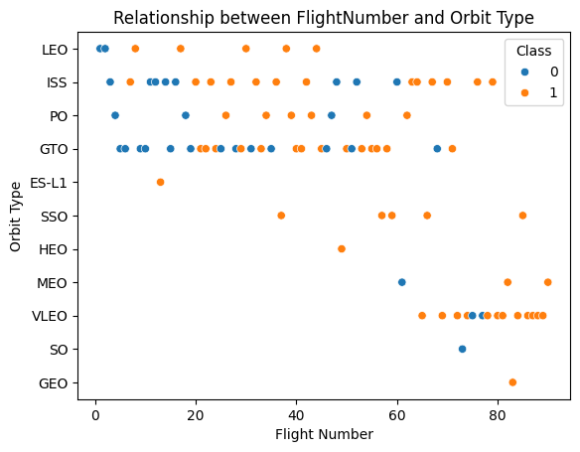
Flight Number vs. Orbit Type
The Flight Number vs. Orbit Type graph reveals the following insights:
LEO (Low Earth Orbit):
A positive correlation is observed between the number of flights and success rates. More flights in LEO tend to show improved reliability, likely due to iterative advancements and optimizations.
GTO (Geostationary Transfer Orbit):
No clear relationship between flight numbers and success rates is evident, suggesting other factors (e.g., payload, mission complexity) play a more significant role in this orbit.
This indicates that while experience (number of flights) boosts success in simpler orbits like LEO, it may not have the same impact on more challenging orbits like GTO.

Slide 29
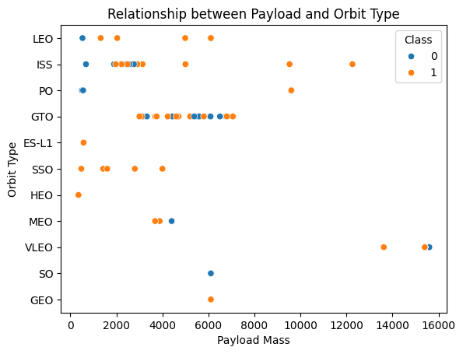
Payload vs. Orbit Type
The Payload vs. Orbit Type graph highlights the following insights:
Impact of Heavy Payloads:
GTO (Geostationary Transfer Orbit): Heavy payloads negatively affect success rates.
LEO (Low Earth Orbit) and Polar (ISS): Heavy payloads have a positive influence on success rates, showcasing the robustness of these orbits for larger missions.
Payload Thresholds:
Lighter payloads tend to perform better across most orbit types, with fewer failures.
These findings underscore the importance of aligning payload capacity with orbit type to maximize mission success.

Slide 30
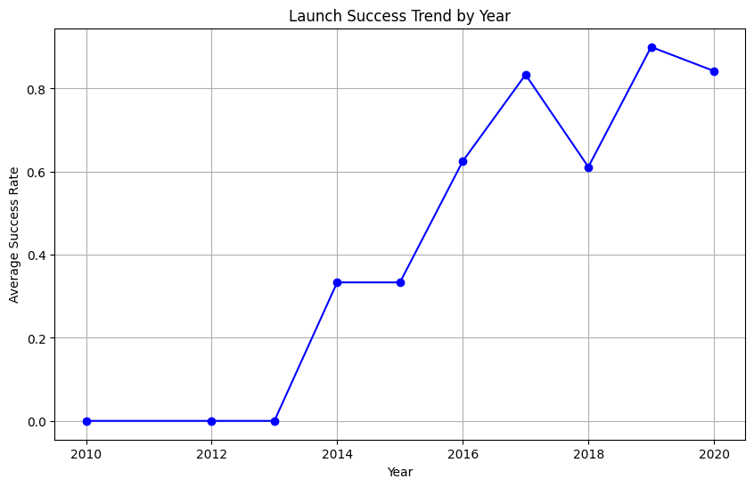
Launch Success Yearly Trend
The Launch Success Yearly Trend graph reveals the following insights:
Consistent Improvement: The success rate of SpaceX launches has steadily increased from 2013 to 2020, reflecting advancements in technology, processes, and experience.
Reliability Over Time: The trend demonstrates SpaceX's growing operational reliability, with fewer failures in recent years.
This trend showcases the company’s commitment to innovation and continuous improvement in launch success rates.

Slide 31
All Launch Site Names
cur.execute("""
SELECT DISTINCT "Launch_Site"
FROM SPACEXTBL;
""")
unique_launch_sites = cur.fetchall()
for site in unique_launch_sites:
print(site[0])
Result:
CCAFS SLC-40
CCAFS LC-40
VAFB SLC-4E
KSC LC-39A
Explanation:
The query retrieves all distinct launch site names from the dataset, showcasing the three primary sites used by SpaceX for its missions. These sites are crucial for their geographical advantages and suitability for various mission types.

Slide 32
Launch Site Names Begin with 'CCA'
cur.execute(SELECT *FROM SPACEXTBL WHERE "Launch_Site" LIKE 'CCA%’ LIMIT 5)
records = cur.fetchall()
for record in records:
print(record)
//The query retrieves launch site names whic start with 'CCA ' from the SPACEXTBL
RESULT:
('2010-06-04', '18:45:00', 'F9 v1.0 B0003', 'CCAFS LC-40', 'Dragon Spacecraft Qualification Unit', 0, 'LEO', 'SpaceX', 'Success', 'Failure (parachute)')
('2010-12-08', '15:43:00', 'F9 v1.0 B0004', 'CCAFS LC-40', 'Dragon demo flight C1, two CubeSats, barrel of Brouere cheese', 0, 'LEO (ISS)', 'NASA (COTS) NRO', 'Success', 'Failure (parachute)')
('2012-05-22', '7:44:00', 'F9 v1.0 B0005', 'CCAFS LC-40', 'Dragon demo flight C2', 525, 'LEO (ISS)', 'NASA (COTS)', 'Success', 'No attempt')
('2012-10-08', '0:35:00', 'F9 v1.0 B0006', 'CCAFS LC-40', 'SpaceX CRS-1', 500, 'LEO (ISS)', 'NASA (CRS)', 'Success', 'No attempt')
('2013-03-01', '15:10:00', 'F9 v1.0 B0007', 'CCAFS LC-40', 'SpaceX CRS-2', 677, 'LEO (ISS)', 'NASA (CRS)', 'Success', 'No attempt')

Slide 33
Total Payload Mass
cur.execute( SELECT SUM("PAYLOAD_MASS__KG_") AS Total_Payload_Mass FROM SPACEXTBL WHERE "Customer" LIKE '%NASA (CRS)%';)
total_payload_mass = cur.fetchone()
print(f"Total Payload Mass: {total_payload_mass[0]} kg")
OUTPUT : Total Payload Mass: 48213 kg
The above Query fetches the total payload mass in kg carried by boosters launched by NASA
He where clauses filters customer record which has substring NASA (CRS) in it and sums the payload mass

Slide 34
Average Payload Mass by F9 v1.1
cur.execute(SELECT AVG("PAYLOAD_MASS__KG_") AS Average_Payload_Mass FROM SPACEXTBL WHERE"Booster_Version" = 'F9 v1.1'; )
average_payload_mass = cur.fetchone()
print(f"Average Payload Mass: {average_payload_mass[0]} kg")
OUTPUT: Average Payload Mass: 2928.4 kg
The above query fetches average payload mass carried by booster f9 v1.1 by filtering out the records by selecting booster version which matches ‘f9 v 1.1’ and calculates the average

Slide 35
First Successful Ground Landing Date
cur.execute("""
SELECT MIN("Date") AS First_Successful_Landing_Date
FROM SPACEXTBL
WHERE "Landing_Outcome" = 'Success (ground pad)';
""")
first_successful_landing_date = cur.fetchone()
print(f"First Successful Landing Date: {first_successful_landing_date[0]}") OUTPUT : First Successful Landing Date: 2015-12-22
The above query sprints the first successful ground landing date by filtering the records where landing_Outcome is compared and only selects those records where landing_outcome is success (ground pad) i.e successfully landed on ground and then selects the minimum date

Slide 36
Successful Drone Ship Landing with Payload between 4000 and 6000
cur.execute("""
SELECT DISTINCT "Booster_Version"
FROM SPACEXTBL
WHERE "Landing_Outcome" = 'Success (drone ship)'
AND "PAYLOAD_MASS__KG_" > 4000
AND "PAYLOAD_MASS__KG_" < 6000;
""")
boosters = cur.fetchall()
for booster in boosters:
print(booster[0])
OUTCOME :
F9 FT B1022
F9 FT B1026
F9 FT B1021.2
F9 FT B1031.2
This Query Filters the records where landing Outcome is success (drone ship) and also payload mass kg is in between 4000 and 6000 and selects all the dinstinct booster versions

Slide 37
Total Number of Successful and Failure Mission Outcomes
cur.execute("""
SELECT Landing_Outcome, COUNT(*) AS TotalCount
FROM SPACEXTBL
GROUP BY Landing_Outcome;
""")
outcomes = cur.fetchall()
outcome_dict = {"Success": 0, "Failure": 0}
for outcome in outcomes:
outcome_dict[outcome[0]] = outcome[1]
print(f"Success: {outcome_dict['Success']} missions")
print(f"Failure: {outcome_dict['Failure']} missions")
OUTPUT : Success: 38 missions
Failure: 3 missions
The Query Groups the records based on the Landing_Outcome and selects the Landing Outcome and total number of records in each possible landing outcome i.e returns the number of success and failues

Slide 38
Boosters Carried Maximum Payload
cur.execute(‘’’SELECT "Booster_Version" FROM SPACEXTBL WHERE "PAYLOAD_MASS__KG_" = ( SELECT MAX("PAYLOAD_MASS__KG_") FROM SPACEXTBL’’’ );
booster_versions = cur.fetchall()
for booster in booster_versions:
print(booster[0])
OUTPUT :
F9 B5 B1048.4 This Query uses a subquery where it selects all the boosters versions who carried payload mass which is
F9 B5 B1049.4 equal to the payload mass which is return by inner query which selects the max payload amount carried
F9 B5 B1051.3 i.e Query returns all the boosters versions which carried maximum payload amount
F9 B5 B1056.4
F9 B5 B1048.5
F9 B5 B1051.4
F9 B5 B1049.5
F9 B5 B1060.2
F9 B5 B1058.3
F9 B5 B1051.6
F9 B5 B1060.3
F9 B5 B1049.7

Slide 39
2015 Launch Records
List the failed landing_outcomes in drone ship, their booster versions, and launch site names for in year 2015
Present your query result with a short explanation here

Slide 40
Rank Landing Outcomes Between 2010-06-04 and 2017-03-20
cur.execute("""
SELECT "Landing_Outcome", COUNT(*) AS Outcome_Count
FROM SPACEXTBL
WHERE "Date" BETWEEN '2010-06-04' AND '2017-03-20'
GROUP BY "Landing_Outcome"
ORDER BY Outcome_Count DESC;
""")
landing_outcomes = cur.fetchall()
for outcome in landing_outcomes:
print(f"{outcome[0]}: {outcome[1]} occurrences")
OUTPUT :
No attempt: 10 occurrences
Success (drone ship): 5 occurrences
Failure (drone ship): 5 occurrences
Success (ground pad): 3 occurrences
Controlled (ocean): 3 occurrences
Uncontrolled (ocean): 2 occurrences
Failure (parachute): 2 occurrences
Precluded (drone ship): 1 occurrences
The query selects all the landing outcomes and the count of them with alias outcome count from spacextbl between the specified dates and then groups them by landing outcome and sorts the result on outcome count in descending order

Slide 41

Section 3

Slide 42
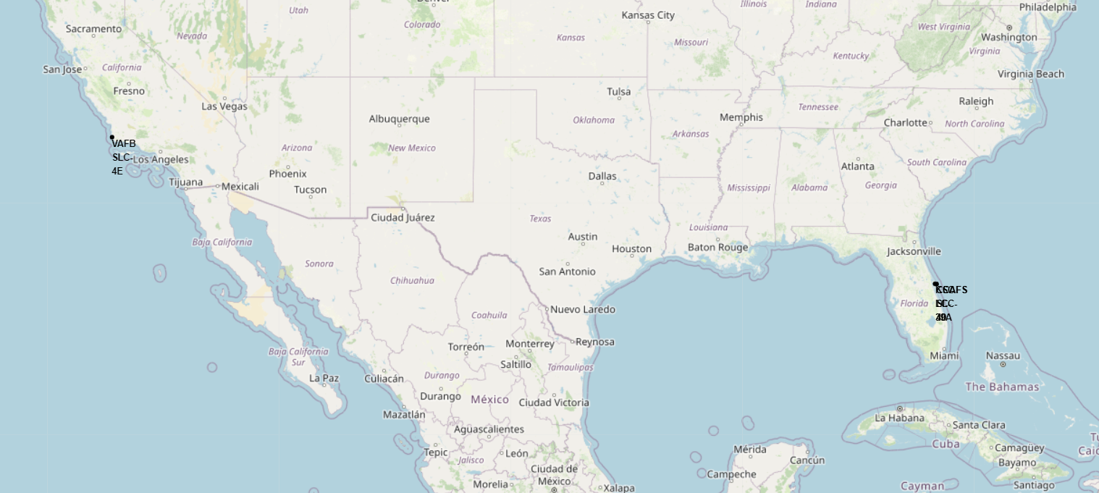
Global Launch Sites and Their Geographical Insights
Image Description:
The Folium map displays all SpaceX launch site locations marked with labeled circles. Key sites include:
CCAFS SLC 40
KSC LC 39A
VAFB SLC 4E
Each marker provides geographical context, showing proximity to the Equator and coastal regions.
Key Elements and Findings:
Proximity to the Equator: Launch sites near the Equator benefit from Earth’s rotational speed, enhancing launch efficiency.
Coastal Locations: All sites are close to coastlines, minimizing risk to populated areas in case of launch anomalies or debris fallout.
Site Success Rates: KSC LC-39A has a notable success rate, making it a preferred launch site.

Slide 43
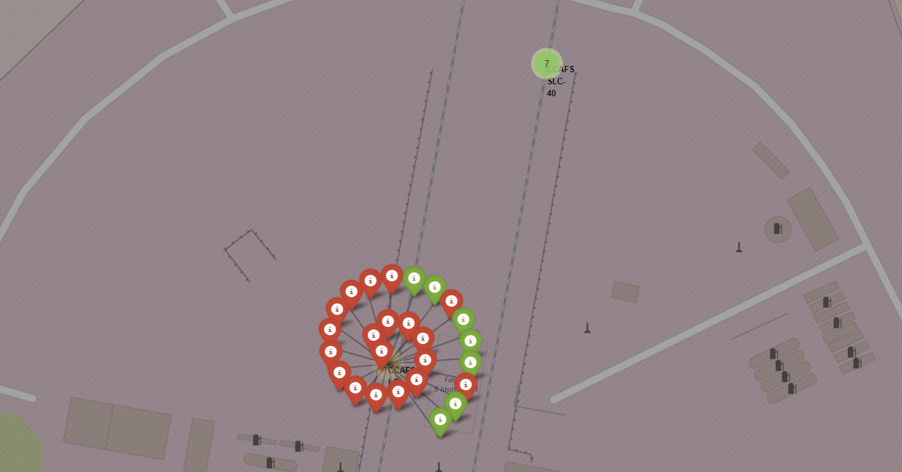
Launch Outcomes by Location: Success vs. Failure
Screenshot Description:
The Folium map displays SpaceX launch outcomes using color-coded markers:
Green Markers: Represent successful launches.
Red Markers: Indicate failed launches.
Markers are distributed across launch sites (e.g., CCAFS SLC 40, KSC LC 39A, VAFB SLC 4E), providing visual clarity on success rates.
Key Elements and Findings:
Visual Outcome Clarity:
Success and failure rates can be quickly assessed by observing marker colors.
KSC LC-39A shows a higher proportion of green markers, indicating superior performance compared to other sites.\
Geographical Impact:
Coastal launch sites with higher success rates indicate optimized launch strategies leveraging proximity to water for safety and technical advantages.
Insights for Improvement:
Sites with lower success rates (more red markers) may require operational enhancements or analysis of failure causes.

Slide 44
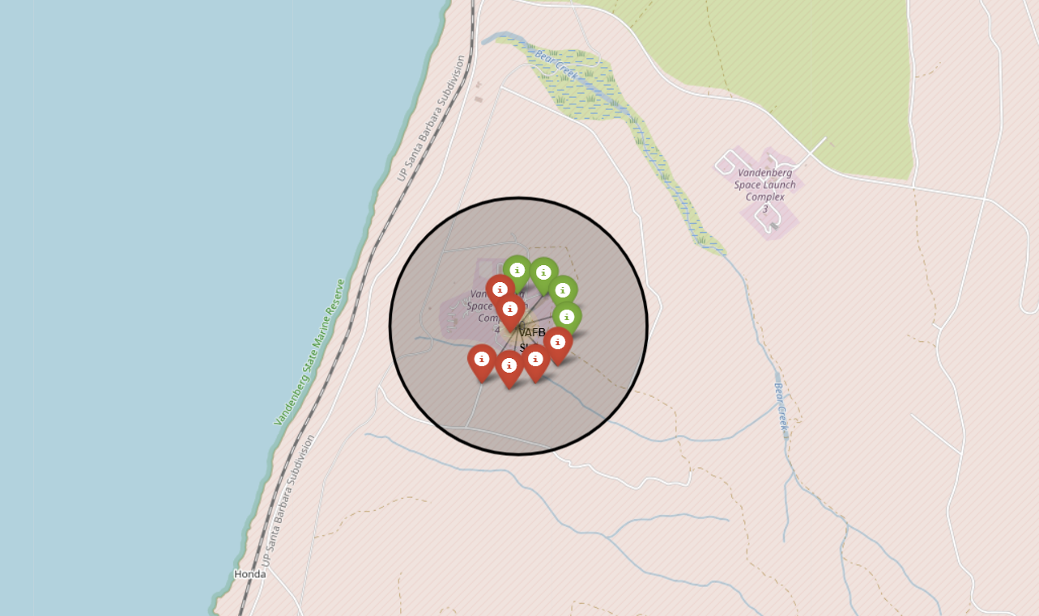
Proximity Analysis: KSC LC-39A and Nearby Infrastructure
Screenshot Description:
The Folium map highlights the KSC LC-39A launch site with calculated distances to key proximities:
Railway: ~15.23 km.
Highway: ~20.28 km.
Coastline: ~14.99 km.
Closest City (Titusville): ~16.32 km.
Key Findings:
Strategic Placement: The site is optimally located near essential infrastructure for logistics and support.
Risk Mitigation: Coastal proximity ensures debris or failed launches have minimal impact on populated areas.
Efficiency: Short distances to transport routes (railway and highway) enhance operational ease and cost efficiency.

Slide 45

Section 4

Slide 46
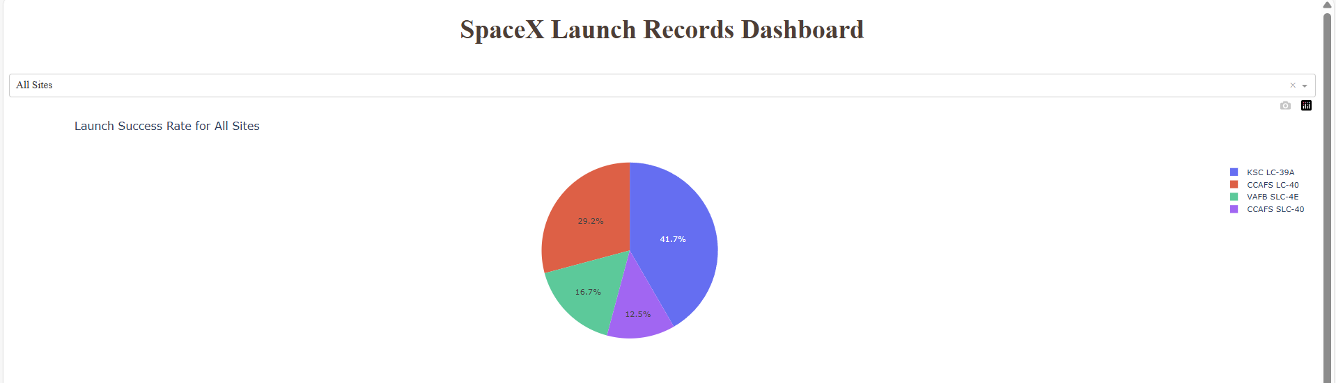
Launch Success Distribution Across Sites

Slide 47
Launch Success Distribution Across Sites
Key Findings:
Visualization: A pie chart shows the proportion of successful launches across all launch sites.
Insights:
KSC LC-39A dominates with the highest number of successful launches.
CCAFS SLC-40 contributes significantly but at a lower success rate compared to KSC LC-39A.
VAFB SLC-4E has the least contributions, reflecting fewer launch attempts or lower success rates.
Conclusion: KSC LC-39A emerges as the most reliable site, emphasizing its operational superiority.

Slide 48
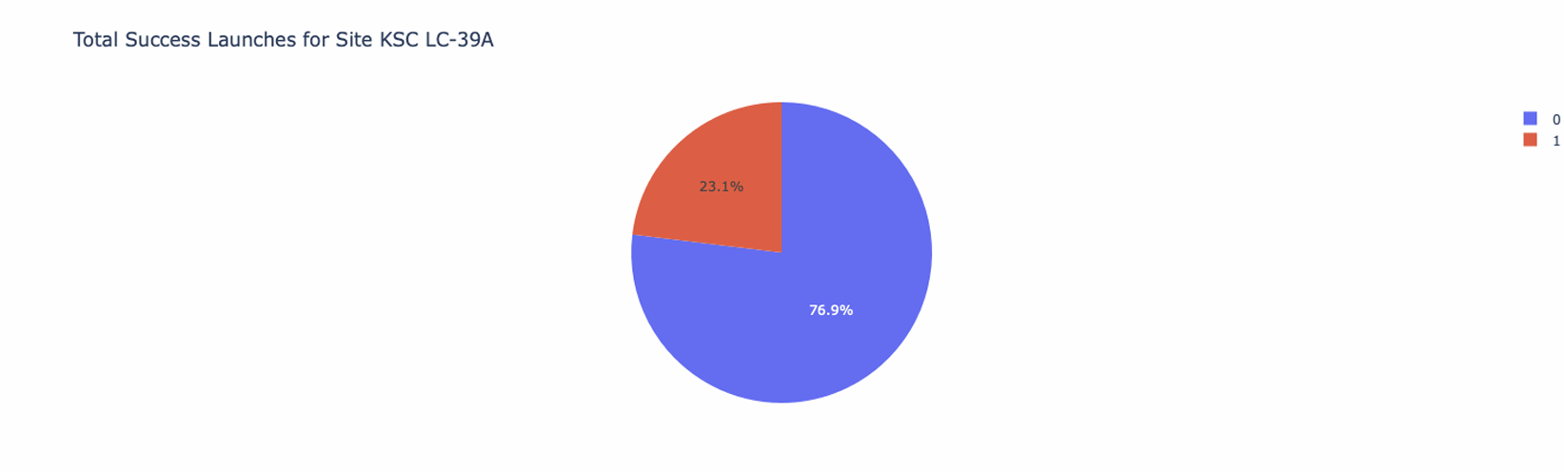
KSC LC-39A: Highest Launch Success Ratio

Slide 49
KSC LC-39A: Highest Launch Success Ratio
Key Findings:
Visualization: A pie chart illustrates the success-to-failure ratio for KSC LC-39A.
Insights:
Success Rate: KSC LC-39A has the highest success ratio, with over 75% of launches being successful.
Failure Rate: The small proportion of failed launches highlights its reliability.
Conclusion: KSC LC-39A's consistent performance makes it a critical asset for SpaceX’s operations, showcasing its operational efficiency and strategic importance.

Slide 50
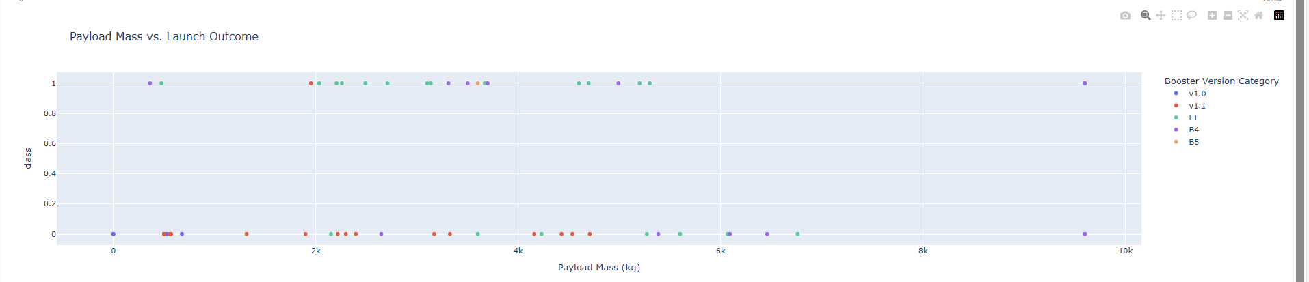
Payload vs. Launch Outcome Across Sites
Key Findings:
Visualization: Scatter plots depict launch outcomes (success/failure) for varying payload ranges, filtered using the slider.
Insights:
Optimal Payload Range: Payloads between 2000–5500 kg exhibit the highest success rate.
Booster Version Performance: Advanced booster versions like Falcon 9 consistently succeed with medium payloads.
Heavy Payload Impact: Launches with payloads exceeding 7000 kg show reduced success rates, likely due to increased technical challenges.
Conclusion: Medium payloads and newer boosters provide the best success rates, suggesting an operational sweet spot for reliable launches.

Slide 51

Section 5

Slide 52
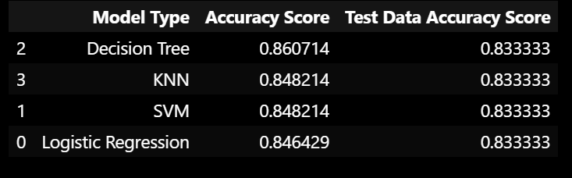
Classification Accuracy
The Decision Tree performs the best with an accuracy score of 0.86 on training set and 0.83 on testing set
and rest all performs similar with log regression slightly less accurate on train set

Slide 53
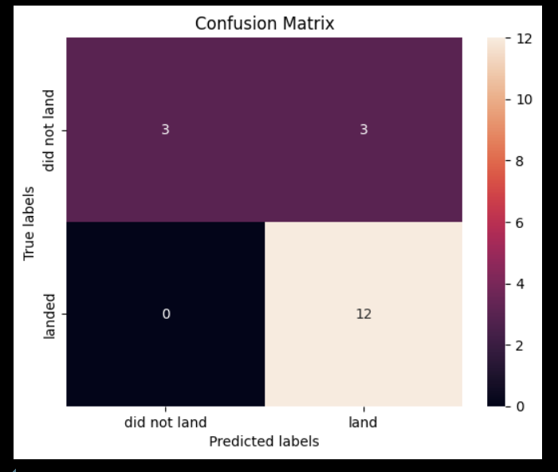
Confusion Matrix
Confusion Matrix of the Decision Tree:
True Positives (12): Correctly predicted "landed."
True Negatives (3): Correctly predicted "did not land."
False Positives (3): Incorrectly predicted "landed" for "did not land."
False Negatives (0): No "landed" cases were missed.
Although 3 cases were incorrectly predicted as "landed" when they did not, which is dangerous for a space shuttle model, it's important to note that no model is perfect. Despite this, the Decision Tree remains the most accurate model in this scenario.

Slide 54
Conclusions
The Decision Tree model was identified as the most accurate and reliable classification algorithm for predicting the success of SpaceX rocket landings.
Launches with lower payload masses and specific orbit types (e.g., GEO, SSO) demonstrated higher success rates, highlighting payload optimization's importance.
Geographical proximity to the equator and coasts significantly influences launch success due to Earth's rotational velocity and safety considerations.
The success rate of SpaceX launches has consistently increased over the years, demonstrating advancements in technology and operational efficiency.
The interactive visualizations and dashboards provide valuable insights into launch patterns, aiding stakeholders in decision-making and mission planning.

Slide 55
Appendix
Code of Decision Tree model :
parameters = {'criterion': ['gini', 'entropy'],
'splitter': ['best', 'random'],
'max_depth': [2*n for n in range(1,10)],
'max_features': ['log2', 'sqrt'],
'min_samples_leaf': [1, 2, 4],
'min_samples_split': [2, 5, 10]}
tree = DecisionTreeClassifier()
tree_cv = GridSearchCV(estimator=tree, param_grid=parameters,cv=10).fit(X_train,Y_train)

Slide 56


